Slide 1
Python class II
Dongho kim

Slide 2
appendex
Class objects
Reg Expression
Sending Email
Multi-threading
Multi-processing
Networking

Slide 3
What is an object?
A software item that contains variable and methods
Object Oriented Design Focuses on
Encapsulation
Dividing the code into a public interface, and private implementation of that interface
Polymorphism
The ability to overload standard operators so that they have appropriate behavior based on their context
Inheritance
The ability to create subclasses that contain specializations of their parents

Slide 4
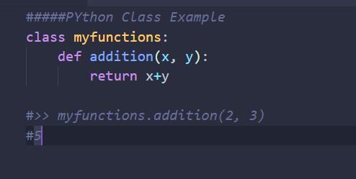
Namespaces
At the simplest level, classes are simply namespaces
It can sometimes be useful to put groups of functions in their own namespace to differentiate these functions from other similarly named ones

Slide 5
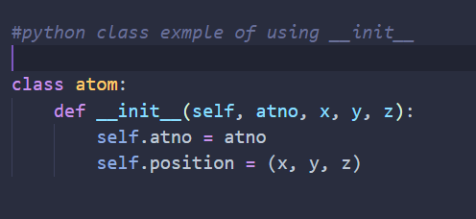
Python classes
Python contains classes that define objects
Objects are instances of class
__init__ is the default constructor
*Self refers to the object itself, like this in java

Slide 6
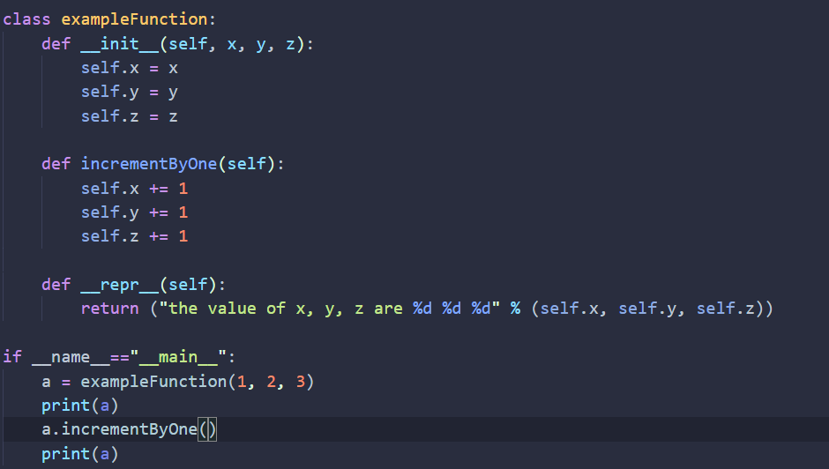
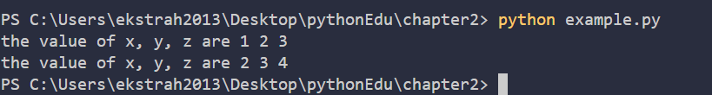
Example: class

Slide 7
Atom class
Overloaded the default constructor
Defined class variables that are persistent and local to the atom object
Good way to manage shared memory:
Instead of passing long lists of arguments, encapsulate some of this data into an object, and pass the object
Much cleaner programs result
Overloaded the print operator
We now want to use the atom class to build molecules

Slide 8
Molecule class

